Slide 1
Notes:
Hello everyone
Good morning and thank you for the invitation and the opportunity to be here today.
I'll start my brief presentation introducing myself

Slide 2
Who am I?
35 years old, Married, 1 baby girl (8 months old).
I am a Football Fan, having also played. I keep playing amongst friends 2 or 3 times a week.
I hold a BSc in Economics and a MSc in Management, where I specialised in strategic Management.
Started my career in accounting. Then moved as a financial analyst for the CFO of a large Pharmaceutical Group.
I started my career at Yunit in 2015 as a Consultant and Analyst.
I have been our CFO since 2019.
jose.brandao@yunit.pt

Slide 3
Agenda
Recovery and Resilience Plan (RRP)
PT2020 & PT2030
Tax Incentives
Case studies
Yunit

Slide 4
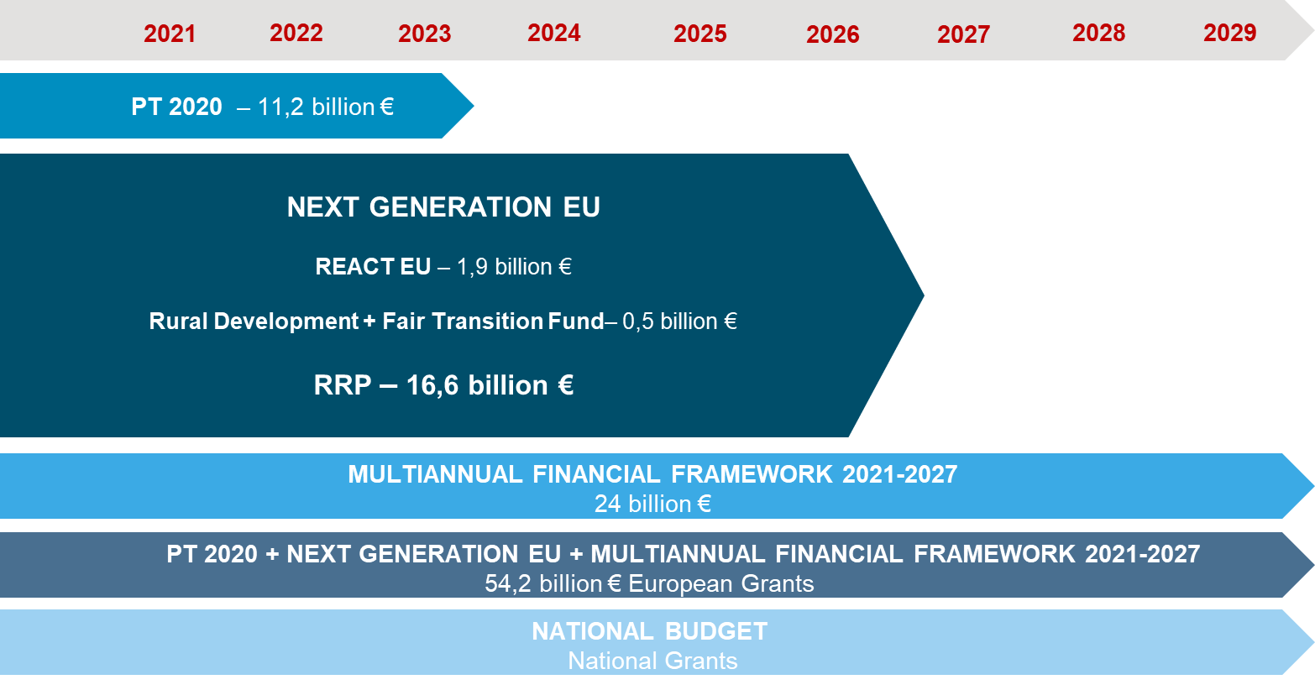
RRP & PT 2020/2030 - overview

Slide 5
Recovery and Resilience Plan (RRP)

Slide 6
Recovery and Resilience Plan (RRP): Main opportunities
Business Innovation Mobilisation/Green Agendas/Alliances
Public Investment
Specific grants: Energy Efficiency in Buildings, Decarbonisation of Industry, Digital Transition
BANCO DO FOMENTO

Slide 7
PT 2020 & PT 2030

Slide 8
PT2020 - TENDERS / CALLS
3. Internationalization
1. R&DT
2. Productive Innovation

Slide 9
PT2020 – R&DT
BENEFICIARIES: SME and Non SME
PROJECT TYPES: CAPEX+OPEX
Research and development (R&D)
Pilots or demonstrations of technological pilot projects
Dissemination of technological results in cooperation with scientific system entities
Strengthening skills in R&D companies
R&D for registration of patents, utility models or model design
Participation in international R&D networks
Acquisition of services for technological development and technology transfer
INCENTIVE RATE: 25% a 85% (non-refundable)

Slide 10
PT2020 – PRODUCTIVE INNOVATION
BENEFICIARIES: SME and Non SME
HOW:
Combines non-refundable incentive with a financial instrument
Banks and SGM issue an opinion on the assessment of the financial and economic risk of the company and the investment, as well as its quality
Banks are indicated on the Application Form
AIM:
Focus on investments in the field of differentiation, diversification and innovation
Technological innovation (product or process, mandatory), marketing and organizational

Slide 11
PT2020 – PRODUCTIVE INNOVATION
ELIGIBLE EXPENSES:
Production machines and equipment
Computer equipment, including software (directly allocated to productive investment)
Technology transfer through the acquisition of patent rights and licenses
Engineering services and studies, diagnostics, audits, marketing plans and architectural projects (not eligible in the case of Non-SME)
Rolling stock (only admissible if it is directly part of the tourist activity)
Construction of buildings and renovation works with the following limits:
Tourism - 60% of eligible expenses
Industry - 35% of eligible expenses
PRIORITY AXIS:
Industry 4.0
Energy Transition
Circular Economy

Slide 12
PT2020 – PRODUCTIVE INNOVATION
BASE RATE:
Investment >= 15 Million € or Non SME.……..……………………………………………..15%
Medium Companies….………………………………………………………………………...35%
Micro and Small Companies …………………………………………………………………45%
SUPPLEMENTS
Inland ………….……………………………...………………………………………………10 p.p
Priority Axis ………..…………………………………………..………………..…………...10 p.p
Qualified Employment Creation in New Production Units ………..….…………………..5 p.p
SME Capitalization.…………………………………………………………………………...5 p.p
MAXIMUM GLOBAL FUNDING RATE = 75%
Combination of a non-refundable incentive with a financial instrument

Slide 13
PT2020 – INTERNATIONALIZATION
BENEFICIARIES: SME
AIM:
Promote the increase in the volume of international sales
Through the development and application of new business models
Valuing in particular the adoption of e-commerce as an internationalization tool
INCENTIVE RATE:
45% (non-refundable) with a €500k incentive limit

Slide 14
PT2020 – INTERNATIONALIZATION
ELIGIBLE EXPENSES:
Visits, prospecting and presence in international markets
International web marketing
Creation and registration of trademarks and design
International development and promotion
Organizational innovation
Digital Economy and ICT
Quality
Industrial property and knowledge transfer
Distribution and logistics
Eco-Innovation
New organizational and marketing methods

Slide 15
PT2020 – MERIT & APPROVAL
RATING CRITERIA
Project Quality
Project coherence and rationality
Innovative nature of the investment
Tradable Goods and Services
Business Impact
International market orientation
Positioning in the Value Chain
Productive Efficiency and Organizational Methods
Impact on the Economy
Smart Specialization Strategy
Job Qualification created
Drag Effects (for large companies)
Impact on the Region
Regional Strategies
Impact on the Regional Economy

Slide 16
EXECUTION TIME - EXAMPLE

Slide 17
Tax Incentives

Slide 18
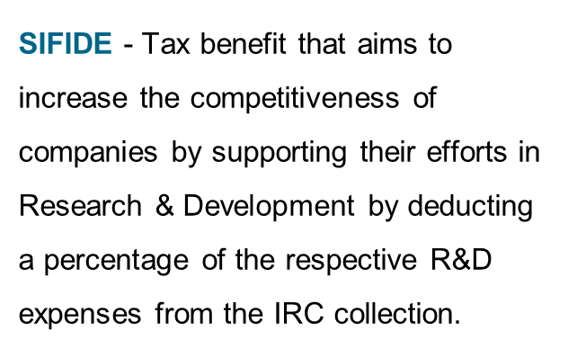
SIFIDE - R&D Tax Incentive System
Incentive’s rate
32.5 up to 82.5%

Slide 19
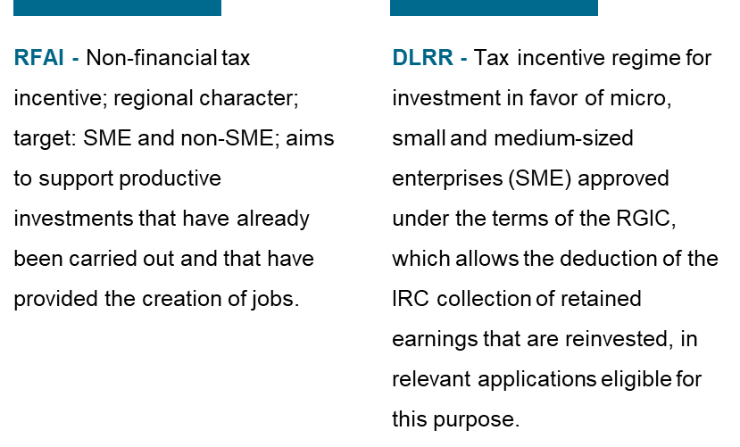
Tax Benefits for Productive Investment

Slide 20
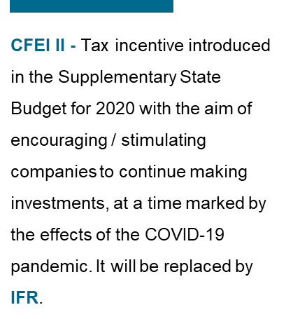
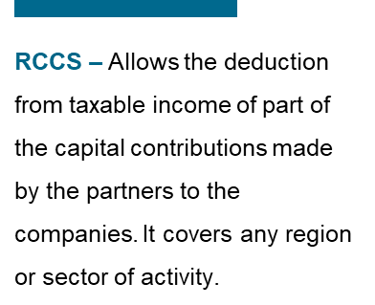
Tax Benefits for Productive Investment

Slide 21
Case studies

Slide 22
Case study 1 – Productive Innovation: Shoes industry
Activity area: Shoes Industry
North of Portugal
Project Goal: Development and Manufacture of fully customisable luxury footwear through digital channels.
REGION
ELIGIBLE INVESTMENT
678.250,00€
70%
INCENTIVE

Slide 23
Case study 2 – Productive Innovation + Internationalization: Moulds
Activity area: Moulds
Region: North of Portugal
INTERNATIONALIZATION
Project Goal: Direct customer acquisition in foreign markets; Strengthening partnerships with foreign companies in the automotive sector
INNOVATION
Project Goal: Development of more complex parts for the automotive sector.
INVESTMENT
236.241,50€
2.244.632,99€
45%
INVESTMENT
INCENTIVE
65%
INCENTIVE

Slide 24
Case study 3 – R&D + SIFIDE: Automation
Activity area: Automation | Region: North of Portugal
SIFIDE
R&DT Individual
INVESTMENT
94.474,07€
INVESTMENT
1.385.389,23€
61.373,70€
80%
TAX CREDIT
INCENTIVE
Project Goal: Development of an automated and autonomous solution for the accurate preparation of chemotherapeutic agents.
Two projects presented:
1 - Automated equipment for welding plastic components
2 – Robotic system capable of performing the polyurethane injection process for the production of steering wheels for automobiles – Project financed by PT2020

Slide 25
Case study 4 – Innovation + RFAI: Plastic
Activity Area: Manufacture of plastic items
Region: Centre of Portugal
INNOVATION
INVESTMENT
1.359.047,32€
50%
INCENTIVE
Project Goal: Acquisition of equipment that allows the injection of new plastic parts whose production does not exist in the national market.
339.761,83 €
RFAI
TAX CREDIT

Slide 26
Case study 5 – Innovation + R&DT + SIFIDE: Health
Activity Area: Research, Technologies and Health Services
Region: West of Portugal
INNOVATION
R&DT
SIFIDE
INVESTMENT
24.967,491,00€
INVESTMENT
2.970,807,00 €
TAX CREDIT
50%
40%
122.353,00€
INCENTIVE
INCENTIVE
Project Goal: Creation of an industrial unit, specialized in lyophilized pharmaceutical products for injections.
Project Goal: Development of a biological product for the treatment of metastatic cancers.

Slide 27
Case study 6 – Innovation: Tourism & Hospitality
Activity Area: Tourism and Hospitality
Lisbon
Projeto Goal: Development of two complementary activities: (i) overnight stay on traditional British and Dutch canal barges and (ii) sightseeing trips on electric charm boats.
REGION
ELIGIBLE INVESTMENT
2.970,807 €
40%
INCENTIVE

Slide 28
Yunit

Slide 29
Our purpose
// Helping companies taking better decisions to promote their growth and competitiveness.
// Generating value for partners and companies, through our distinctive skills.
Notes:
And what is the purpose of Yunit Consulting? Why we do what we do and get up every morning?

Slide 30
Differentiating factors
// Combination of a diversified team: we offer to our customers a wide range of different knowledge areas and skills combining management, finance, economics, engineering, biology, nanotechnology, etc.
// Proximity and empathy: the fact that we are also an SME which makes us more aware about managers’ pains, dreams and ambitions.
Notes:
To do what we do, we believe we have two distinctive factors

Slide 31
Who we “formally” are?
// Management consultancy company focused on supporting SMEs’ financing and investment projects.
// Aim to be present in the moments of change and transformation, across all business process since estrategic reflection to implementation and execution.
// + 35 employees
// Nationwide presence (Offices in Lisbon and Oporto)
// Helping companies since 2010
Notes:
Here it is our more formal and institutional description

Slide 32
Core competences
Tax
Benefits
Corporate Finance
Investment and Financing
(PRR, PT 2020/2030,…)
M&A
Innovation Management
Operational Efficiency
Notes:
We are foucused on adding value to our customers offering these core competences

Slide 33
Institutional Partners

Slide 34
Our challenge
Your vision brought you here today.
How far will we take your company to?
Notes:
And I finish with a challenge for you!

